Slide 1

Fair and Ethical Admissions: Mitigating Bias with Data-Driven Solutions
A Case of iLink University
Team- “Data Ninjas” Team Members: Sushant Magar and Karan Shrestha SAS Hackathon, 2024

Slide 2

Problem Overview
Challenge
Biases in historical admissions data
Preferences for legacy admissions
Disparities related to demographic factors like gender and cultural identity
Impact
Perpetuates unfairness
Leads to an underrepresentation of certain demographic groups
Undermines diversity within the M.S. in Analytics program
Goal
Develop a data-driven, ethical admissions process
Mitigate bias and promote fairness
Ensure evaluation of all applicants based on their true potential

Slide 3
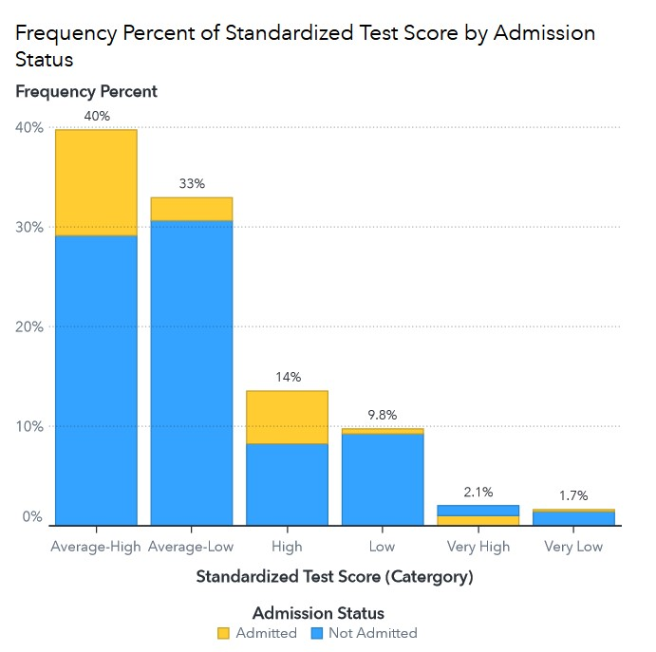
Data Discovery (EDA)
Dataset Overview
Dataset Size: 1,000 applicants
Target Variable: Admitted (Yes = 1, No = 0)
Admission Breakdown: 80% not admitted, 20% admitted
Feature Engineering Applied to
Test Scores: Categorized into 'Low,' 'Average,' 'High'
Work Experience, Recommendations
Key Findings
High Test Scores: 52% admission rate
Weak Recommendations: Only 2.5% admission rate

Slide 4
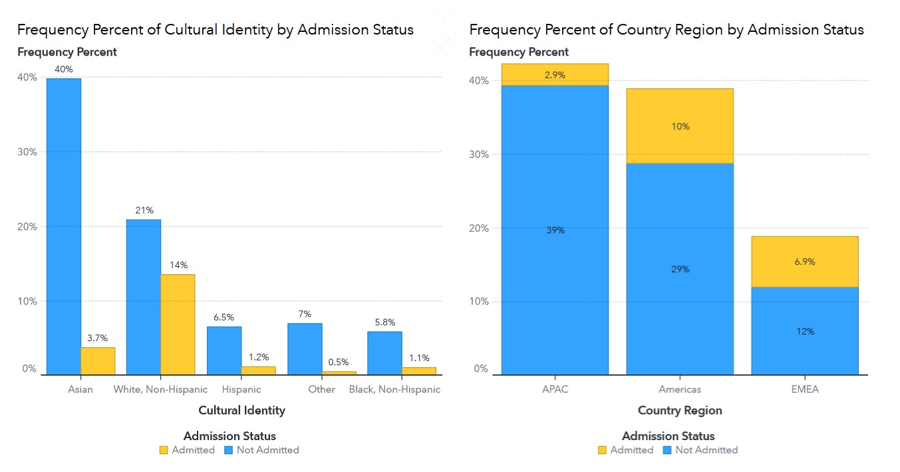
Data Discovery (EDA)
Bias Indications:
Cultural Bias: White, Non-Hispanic admitted at 14%, Asians at 3.7%.
Regional Bias: Americas 10%, APAC 2.9%, EMEA 6.9%.
Underrepresentation: Black and Hispanic rates lower than White, Non-Hispanic.

Slide 5
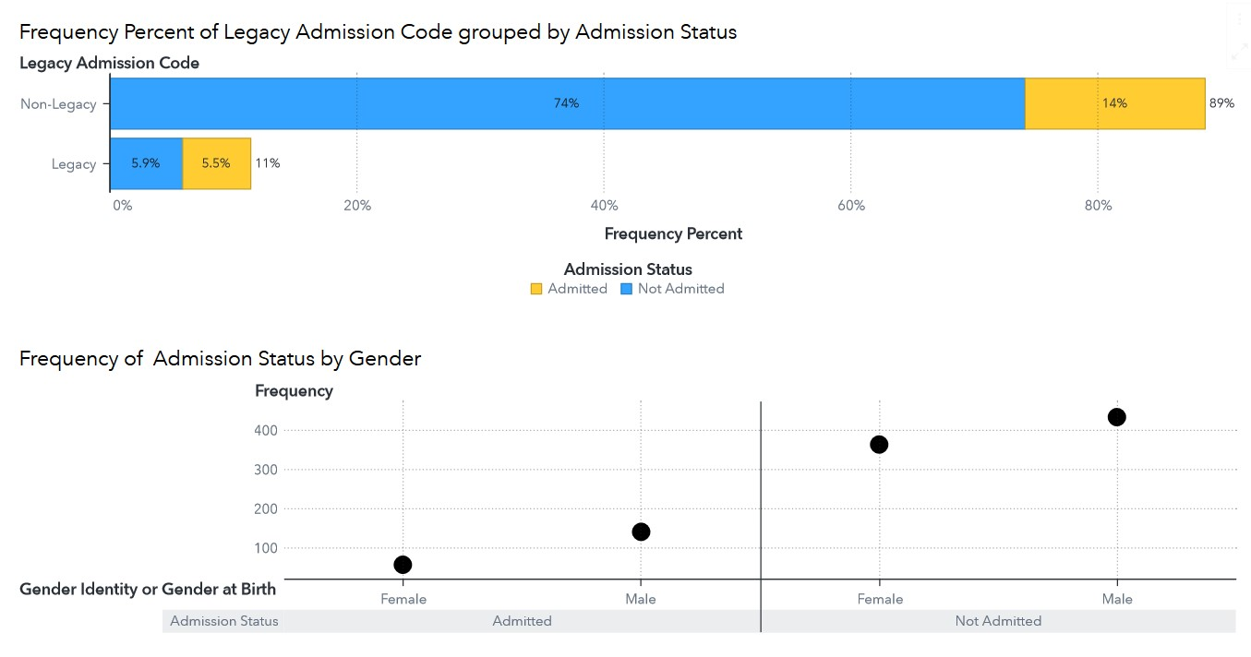
Data Discovery (EDA)
Bias Indications:
Legacy Bias: Legacy admitted at 48%, non-legacy at 16%.
Gender Bias: Males admitted more often than females.
Rejection Rates: Non-legacy 74%, legacy 52%.

Slide 6
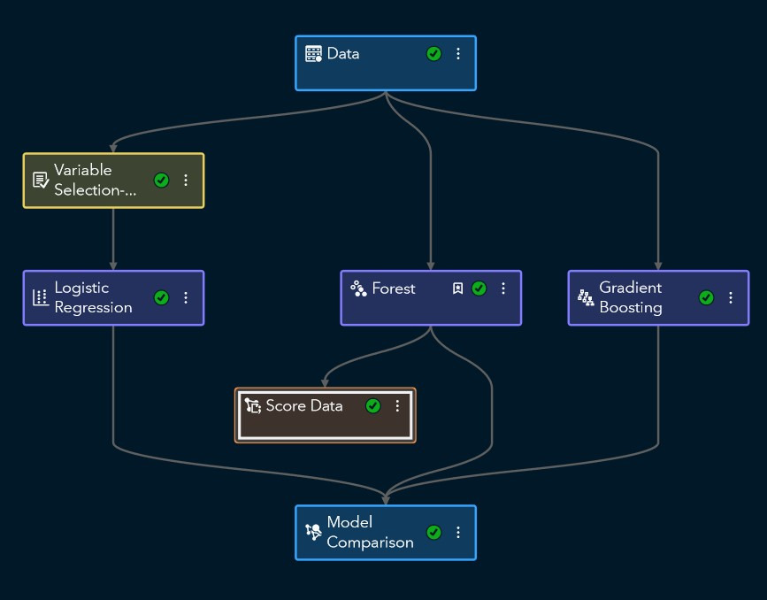
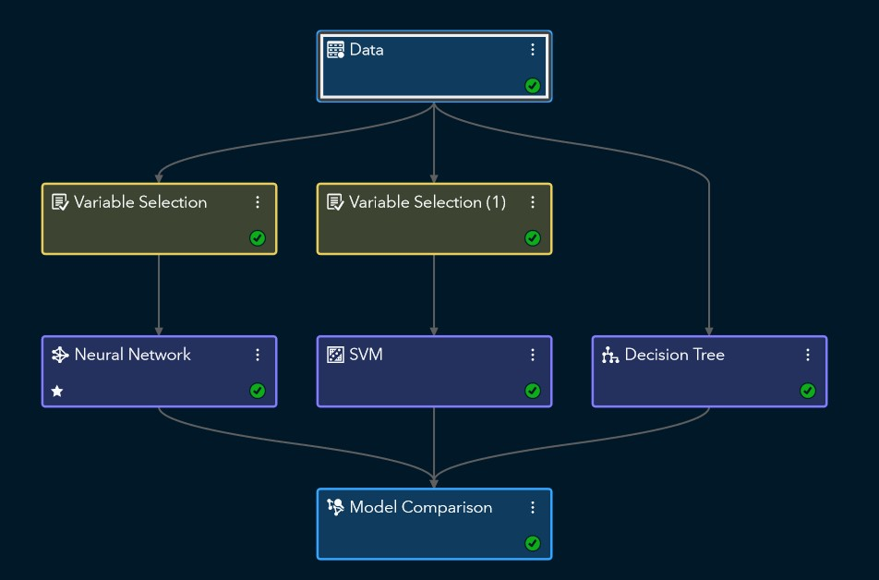
Initial Model Building
Model Strategies and Pipeline Design
Pipeline 1: Logistic Regression, Forest, Gradient Boosting.
Pipeline 2: SVM (RBF kernel), Neural Networks, Decision Trees.
Variable Selection: Applied to Logistic Regression, SVM, and Neural Networks to optimize performance.
Exclusion of Mission Statement: Omitted due to subjectivity and missing data.
Pipeline 1
Pipeline 2

Slide 7
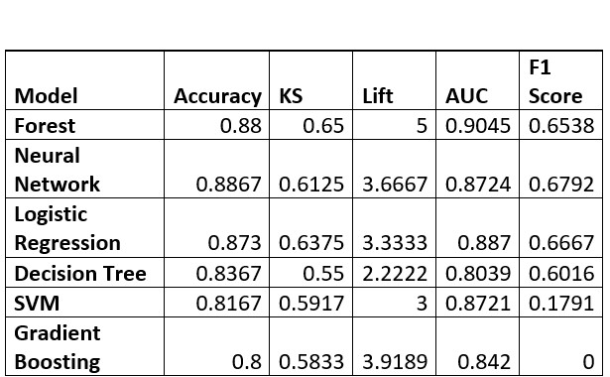
The Champion Model
Forest Model: Outperformed others with high accuracy, KS, and AUC.
Class Imbalance: 20% admitted; adjusted by sorting predictions by probability to meet the target of 40 students.
Bias Indicators: Disparities detected in cultural identity, gender, and legacy status, prompting bias assessment.
Model Comparison

Slide 8
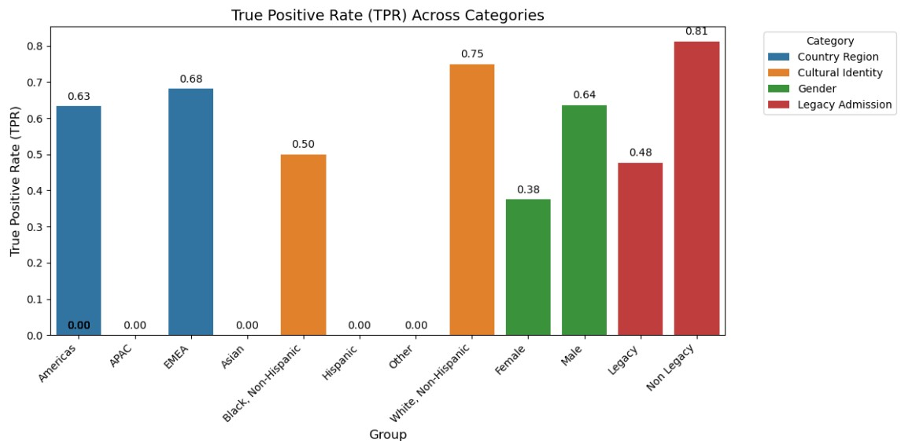
BIAS Assessment: Identifying Inequities
Performance Bias: Significant disparities in TPR across groups (e.g., 75% for White, 0% for Asian).
Prediction Bias: Model more likely to favor specific groups (e.g., White over Asian, male over female).
Next Steps: Address biases to ensure fairer outcomes.

Slide 9

Rebuilding The Model
Rebuilding the Model for Fairness
To ensure fairness, we removed key biased variables: Gender, Cultural Identity, Country/Region, and Legacy Admission.
This action aimed to eliminate skewed predictions and provide an equitable admissions process across all groups.
The rebuilt model focused solely on merit-driven variables, reducing the risk of biased decision-making.

Slide 10
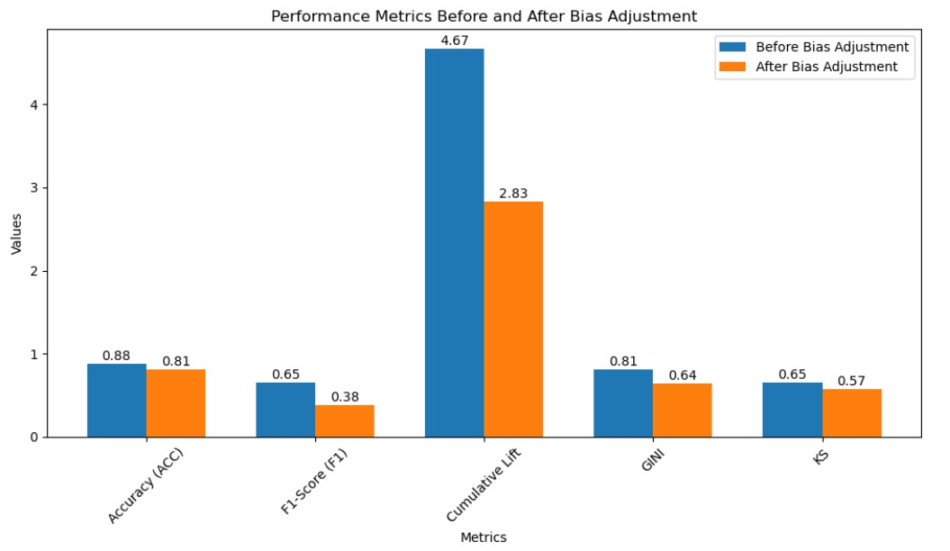
The Trade Offs: Performance Vs. Fairness
Compromised Performance
Accuracy dropped by 6.7%, indicating it’s slightly less precise in predicting admissions.
F1 Score decreased by 27.6%, showing a reduced ability to balance precision and recall, meaning the model struggles more to predict true admissions and avoid false positives.
Cumulative Lift also declined, indicating the model is now less effective at identifying top candidates compared to random guessing

Slide 11
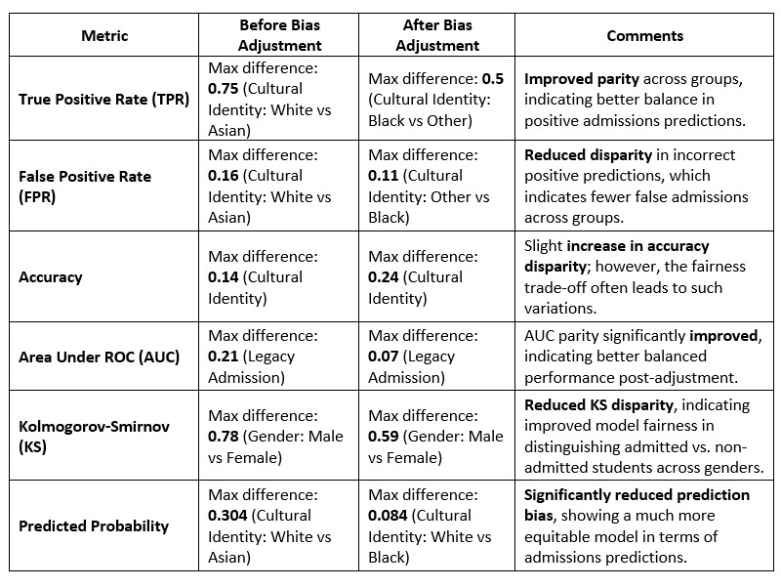
The Trade Offs: Performance Vs. Fairness
Improved Fairness

Slide 12
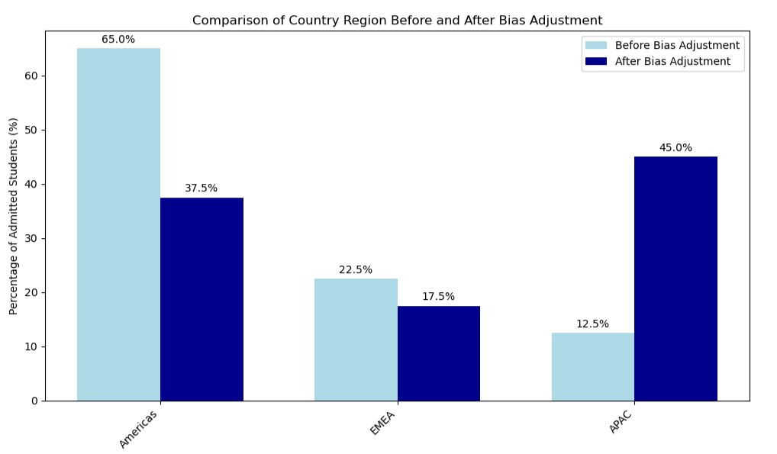
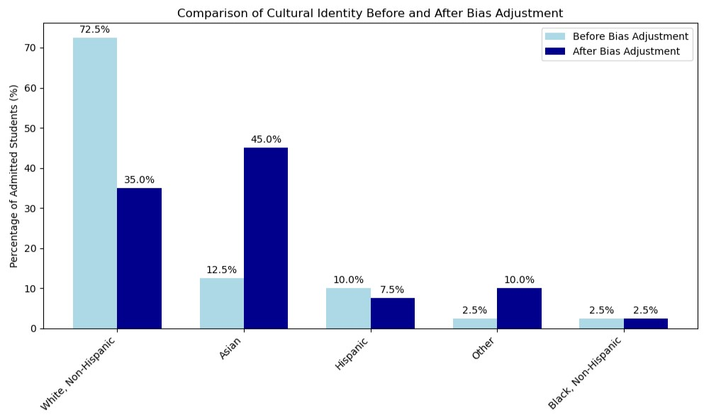
Admissions: Before vs. After Bias Adjustment
Shifts in Diversity and Representation
Cultural Identity
More equitable admissions process that actively recognizes and includes underrepresented groups post adjustment.
Representation of Asian applicants increased significantly from 12.5% to 45%, while White applicants decreased from 72.5% to 35%.
Country Region
Commitment to global diversity, ensuring that students from various regions contribute to a richer academic environment.
Admissions from the Americas dropped from 65% to 37.5%, while representation from the APAC region rose from 12.5% to 45%.

Slide 13
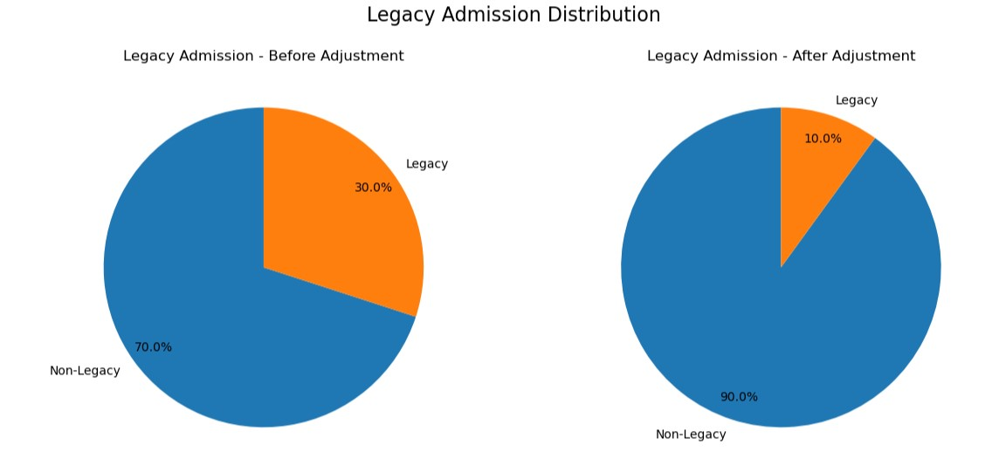
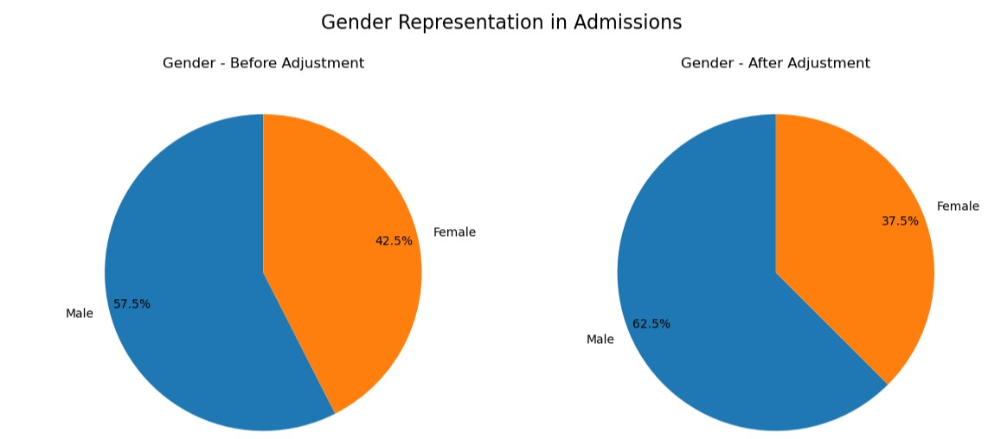
Admissions: Before vs. After Bias Adjustment
Shifts in Diversity and Representation
Legacy Admission
move towards a merit-based admissions process, prioritizing qualifications over legacy status, which enhances fairness and inclusivity.
Percentage of legacy students admitted dropped from 30% to 10%, while non-legacy admissions increased from 70% to 90%.
Gender
Male admissions rose from 57.5% to 62.5%, while female admissions decreased from 42.5% to 37.5%.
The reduction in female admissions highlights a cost of fairness that the university must address through policies aimed at ensuring gender equality and representation.

Slide 14
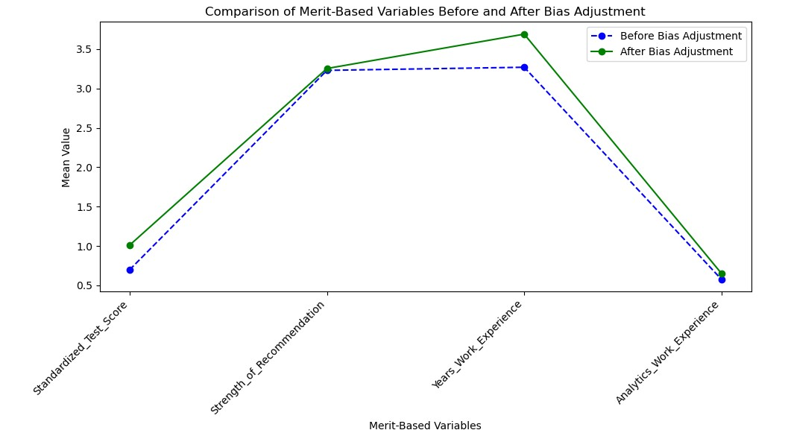
Merit-Based Admissions: Reinforcing Bias Adjustment
Stronger Academic Performance:
Increased average standardized test scores post-adjustment, emphasizing high-achieving candidates.
Relevant Work Experience:
Rise in mean years of work experience, favoring candidates with practical skills.
Additional Considerations:
Strength of Recommendation: Consistent importance of peer and mentor support.
Analytics Work Experience: Increased focus on candidates with specialized skills.
Diverse Perspectives:
Prioritizing merit fosters a well-rounded student body, enriching the academic environment.

Slide 15

Bringing Fairness to Admissions: A Balanced Approach
Mission
Removing bias for fair, merit-based admissions
Key Wins
Increased representation for underrepresented groups
Reduced legacy admissions
Balanced academic standards with fairness
The Human Touch
SOPs and Mission Statements matter!
Call to Action
Combining data and human judgment for a better future
Standardized assessments or situational judgment tests for soft skills and cultural competency
Project-based for practical evidence of skills and experience beyond personal narratives
Gather behavioral data from how applicants interact with application platforms

Slide 16

THANK YOU FOR YOUR TIME!
TEAM DATA NINJAS

